Slide 1
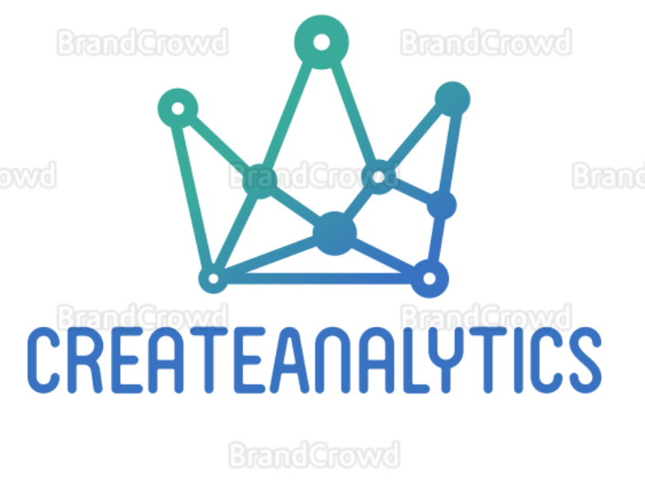
SPRING SCHOOL 2021
Data Science
Team 6
Truong Hoang Xuan Vignesh Somasundaram Shankar Lokeshwara Danil Degtarenko Ilya Kharebashvili Ivanna Nahuliak Misha Navudylo

Slide 2

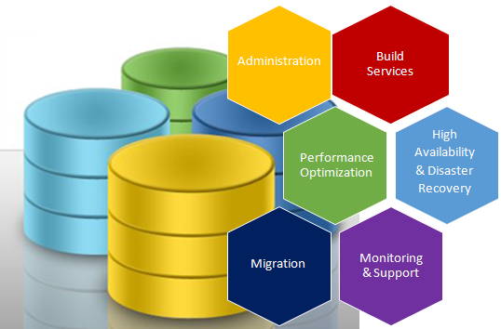
Stakeholder Analysis
Vision
A central database for
Car Sport Racing over the world
Goal
Source: https://www.visolve.com
Create Database for real-time data taken from racing cars
Create Database for history data about car racing
API for media and press produce racing news
A platform where fans can find all information about car racing
An analytical system based on the current data

Slide 3
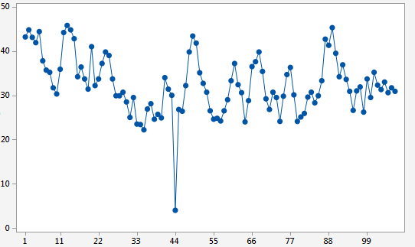
Stakeholder Analysis
Requirement
Create Database for real-time data taken from racing cars
Database is optimized for time series including
sensors data from racing cars
the weather at the place where the racing is taking place
Visualize real-time data on dashboards
Source: https://support.minitab.com

Slide 4
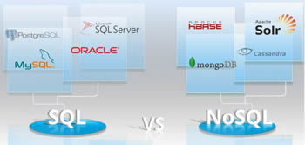
Stakeholder Analysis
Requirement
2. Create Database for history data about car racing
NonSQL Database is a combination of different data source
optimize for images, videos, news
Relational database
Biography about the pilots, tournaments
Live update for racing events are taking place
Source: https://www.differencebetween.info

Slide 5
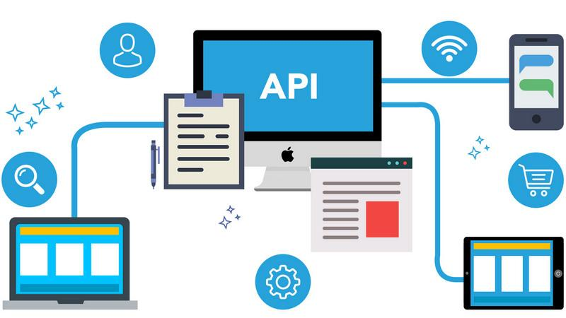
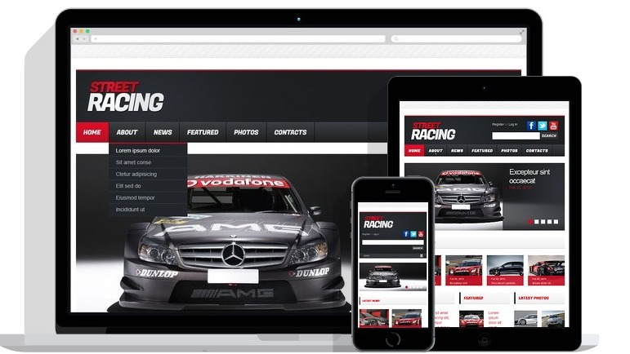
Stakeholder Analysis
Requirement
3. API for media and press produce racing news
Provide an API for privileged client get data and produce car racing news
4. A platform where fans can find all information about car racing
Source: https://teks.co.in
An mobile app and website for fans can find schedule of racing event all over the world
Source: http://scr.templatemonster.com

Slide 6

Stakeholder Analysis
Requirement
5. An analytical system based on the current data
Using machine learning and data analysis to predict, classify data. These information should provide clients who want to use our data for their purpose
Source: https://www.symmetrymagazine.org

Slide 7

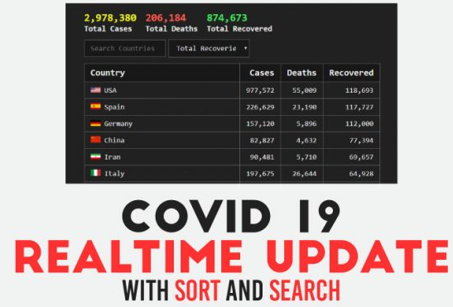


Requirements Elicitation
From stakeholder analysis we lay down our proposals below:
An interactive interface for the user to display, modify and update entries
Real time update
Different types of subscribers
→ Normal subscribers
→ Commercial subscribers
Scalable and integratable

Slide 8

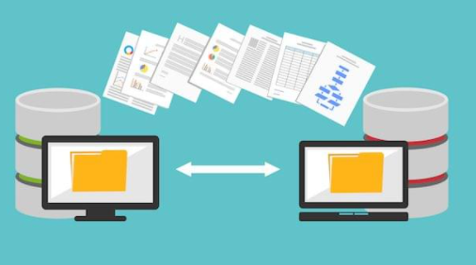
Requirements Elicitation
Plausible data Analytics
Provision for data migration from different sources with accuracy

Slide 9

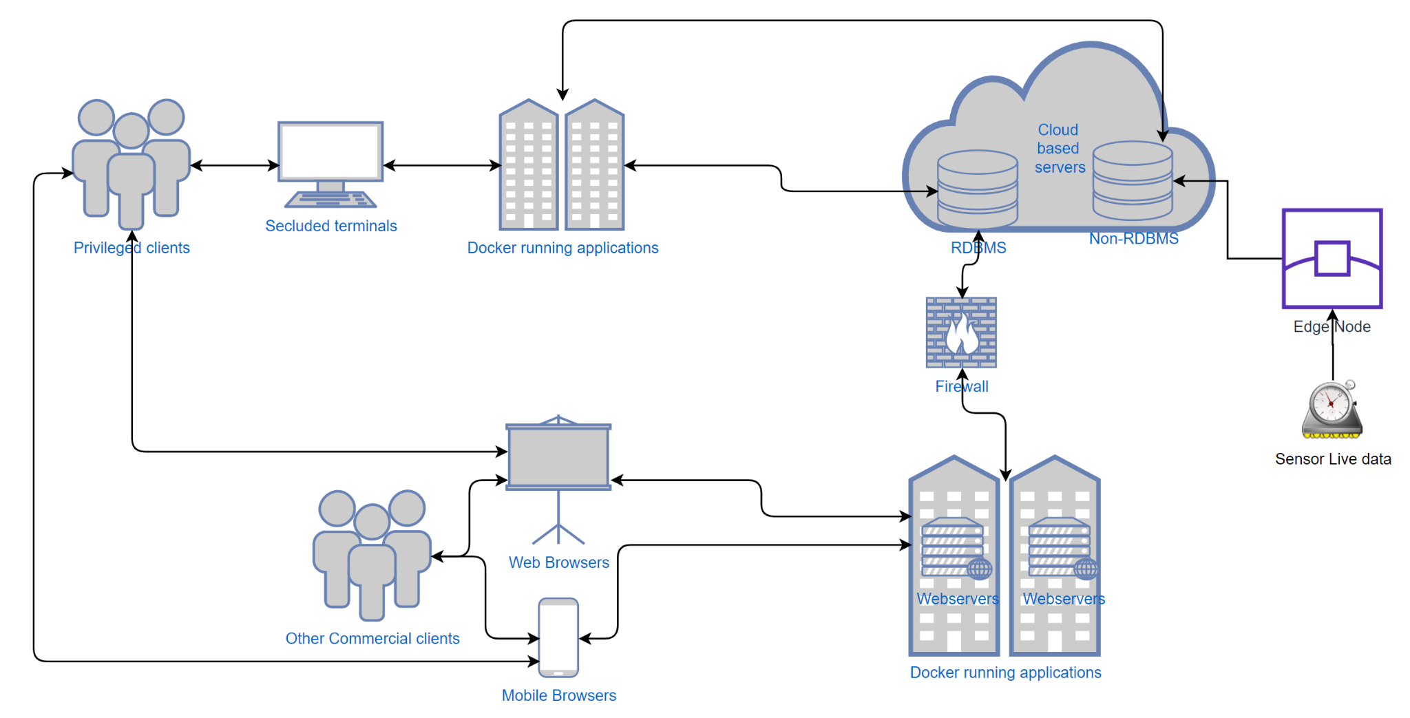
Proposed System
Network Diagram

Slide 10
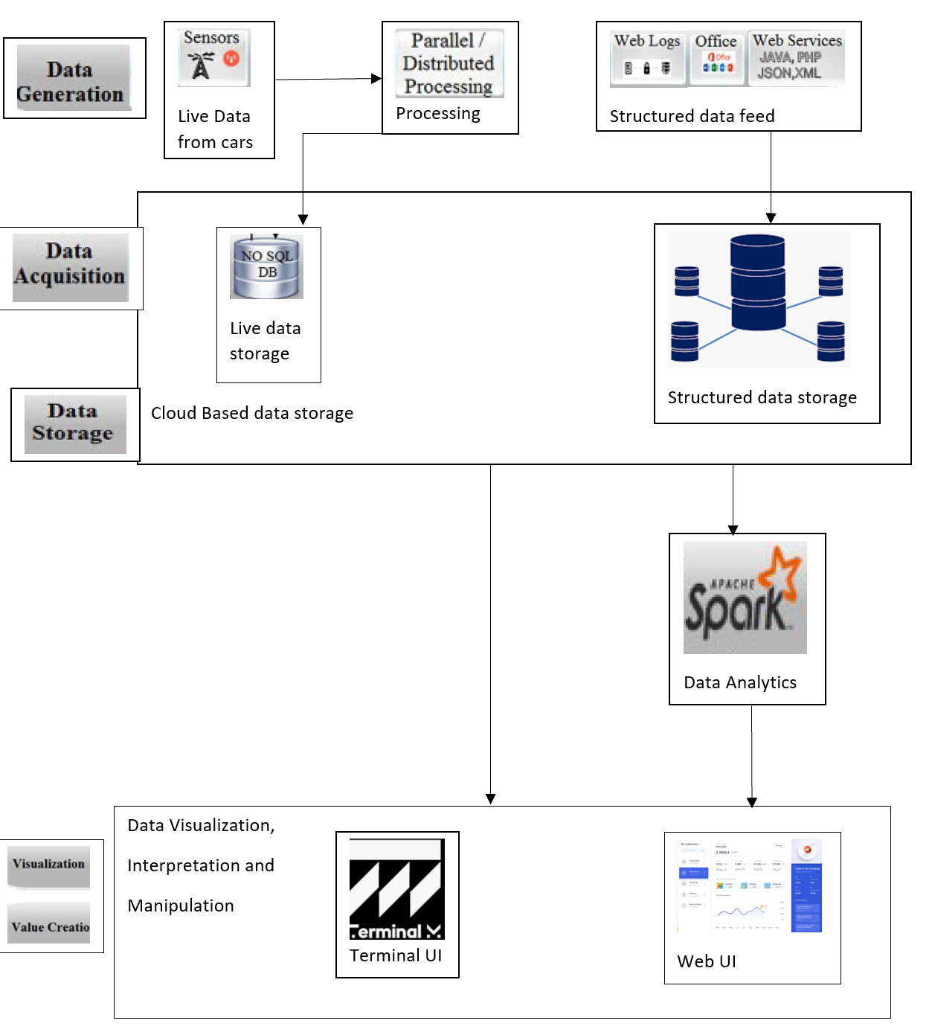
System Architecture
Architecture

Slide 11

Resource Analysis
Rationale behind choosing Relational database
Large amounts of structured data
Information from multiple files can be linked through “keys.”
Client requirements on application requiring strong transactional functionality, data mining and complex reporting
Data has a lot of relationships
Predictability based on past data and report generation for the same
Cloud Based infrastructure
Scope for future expansion, scalable and flexible
Support from major tech firms
Less maintenance from the owners side
Pay as used type of resource
Based on the above factors and analysis Amazon Relational Database Service is decided as the cloud based data base four system and application.

Slide 12
Resource Analysis
Need for Dockerized containers
To support continuous build, deploy, run, update of data in the databas.
Full control on the database.
Continuous integration and continuous delivery of data into the database
Traffic free routing of changes into the database.
Real-time update
Analytics - Apache Spark (Compared among, Spart, Hadoop and Flink)
Easy-to-use APIs
One of the best for iterative algorithms
Being a more mature framework and superior in terms of market share and community.
Includes a richer set of operations and a wide range of tools
Better performance in terms of time and resources with variations in configurable parameters like clusters, number of nodes, parallelism etc
Runs Everywhere

Slide 13
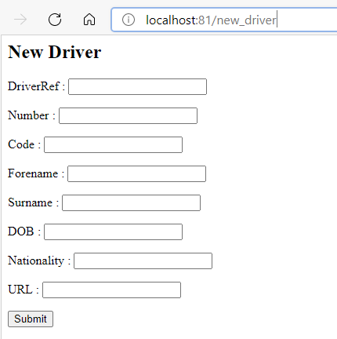
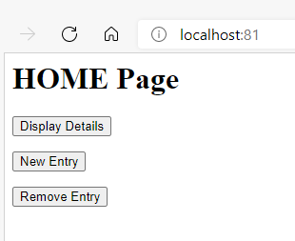
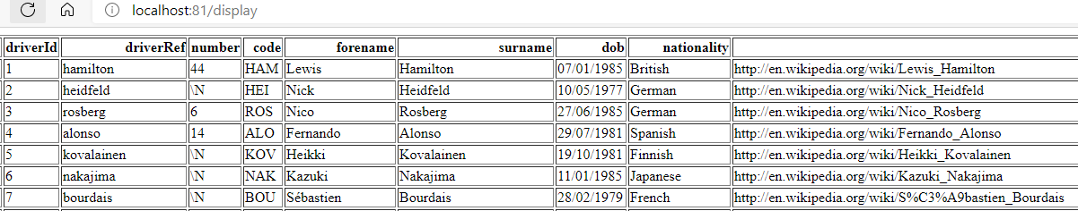
Demo
Adding a new Entry →
Example for a homepage display
for driver details table →
Display the existing data
Remove entity

Slide 14
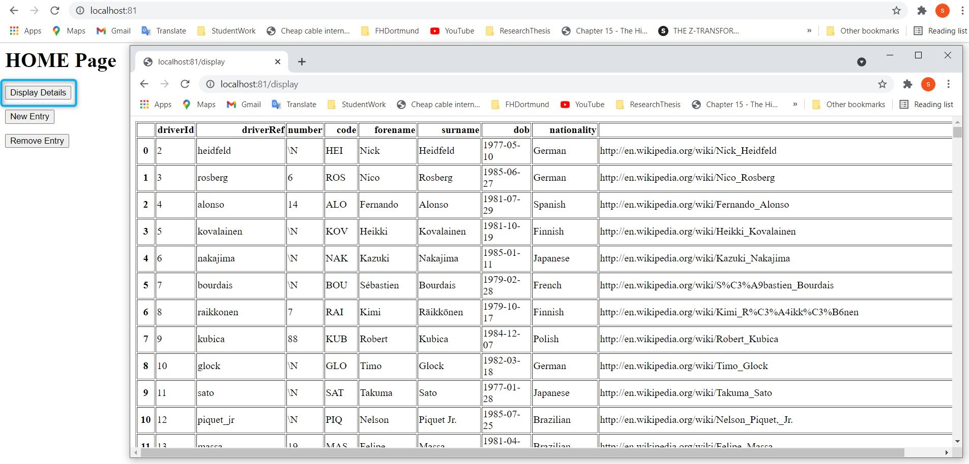
Demo
Display driver info

Slide 15
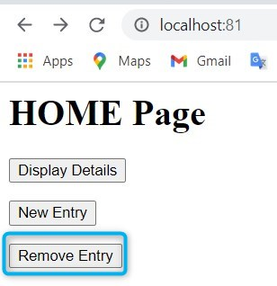
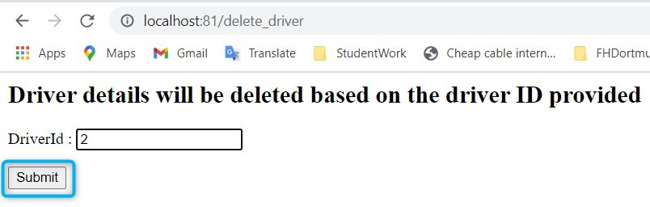
Demo
Delete driver info

Slide 16
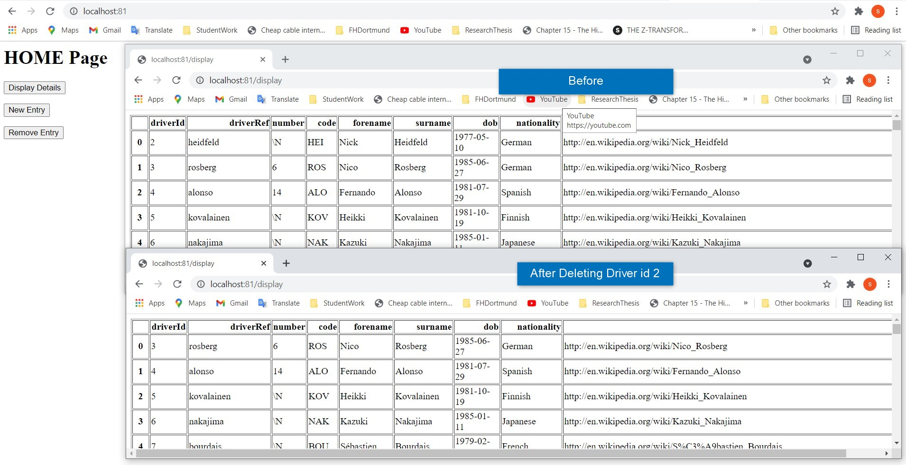
Demo
Delete driver info

Slide 17
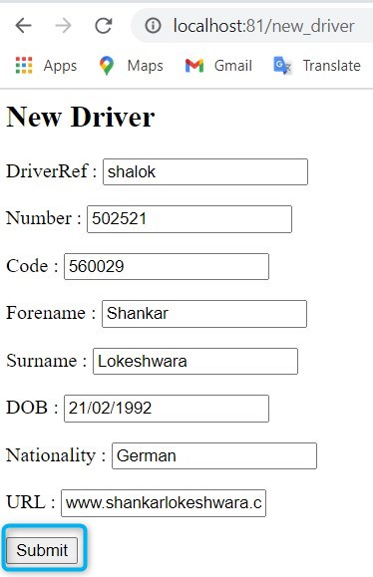
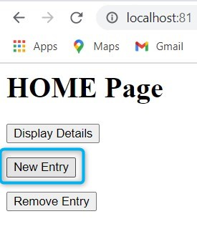
Demo
Add driver info

Slide 18
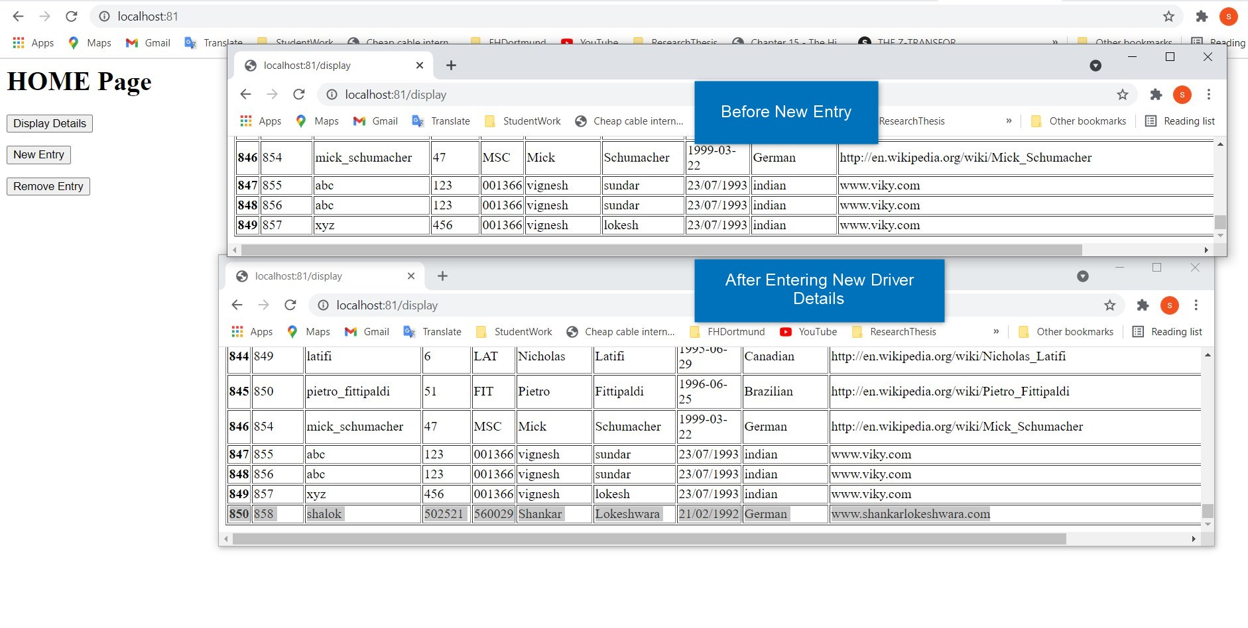
Demo
Add driver info

Slide 19
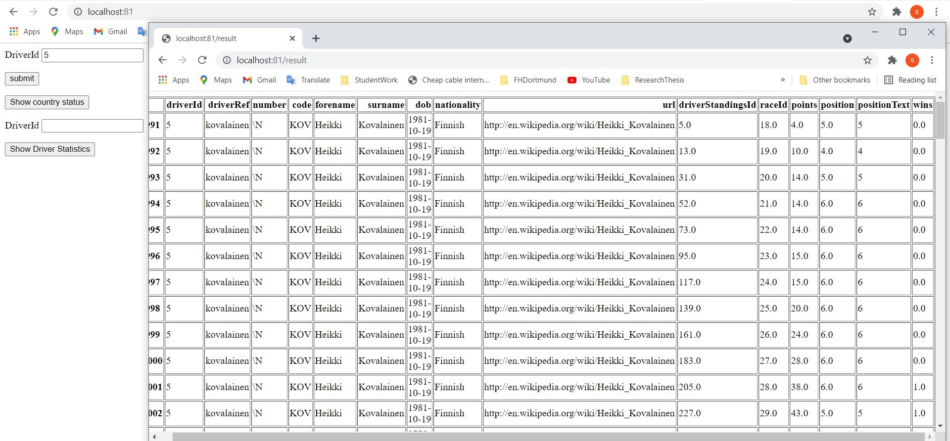
Demo

Slide 20
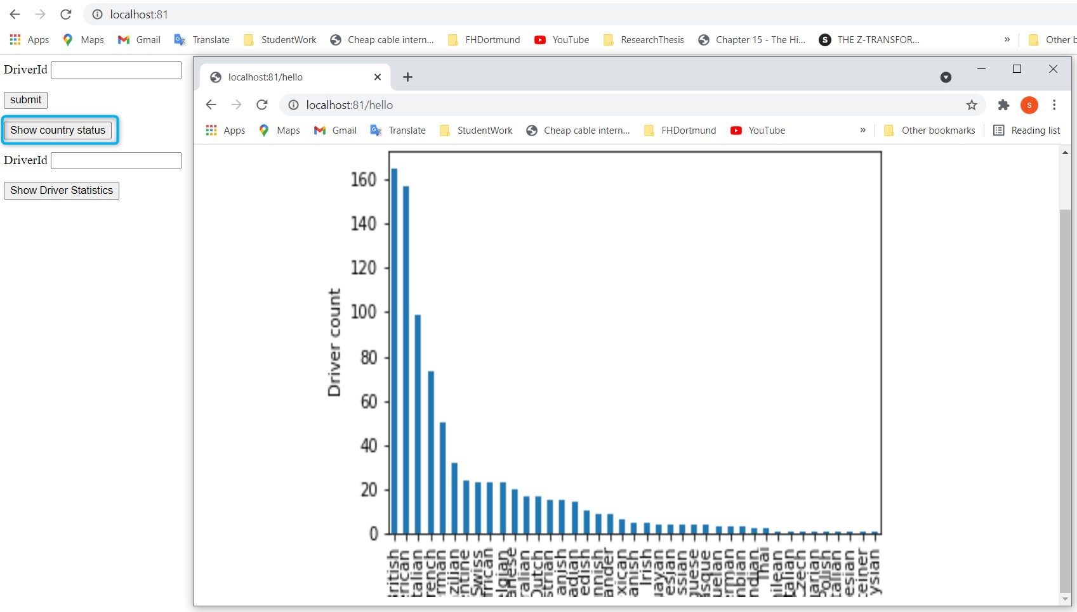
Demo

Slide 21
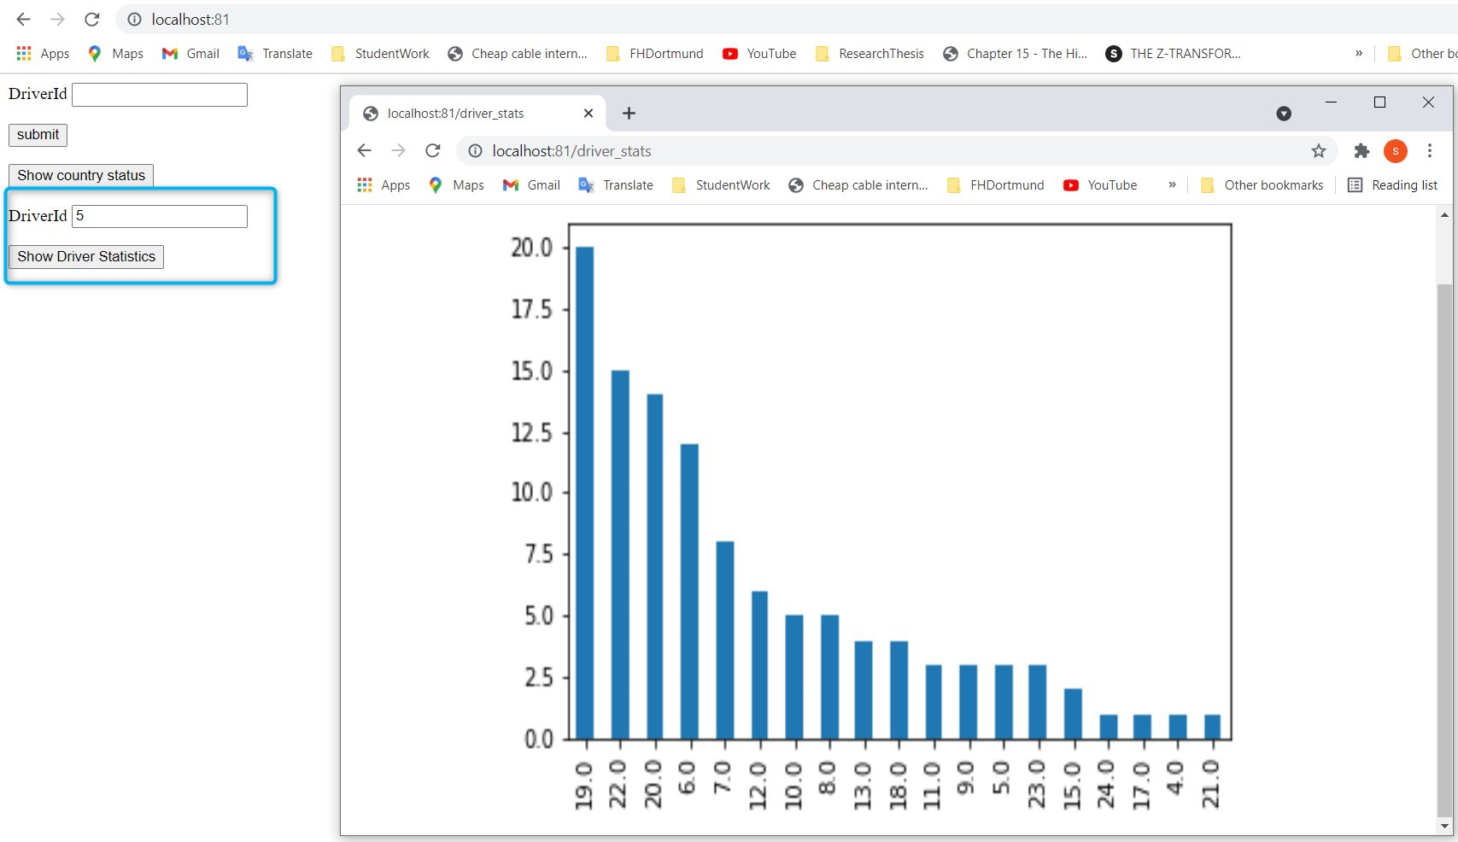
Demo

Slide 22
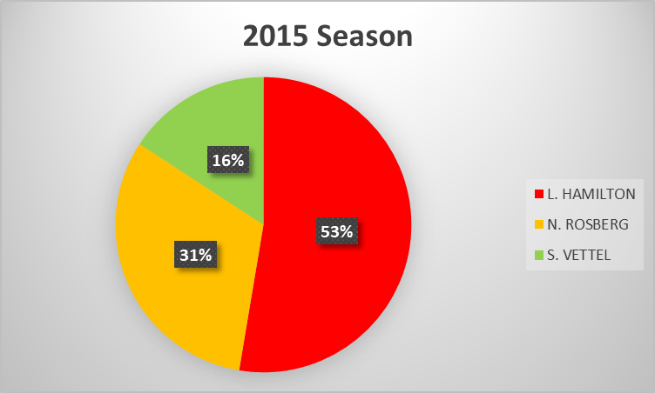
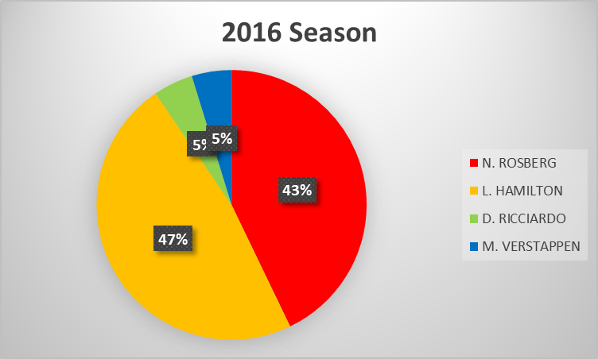
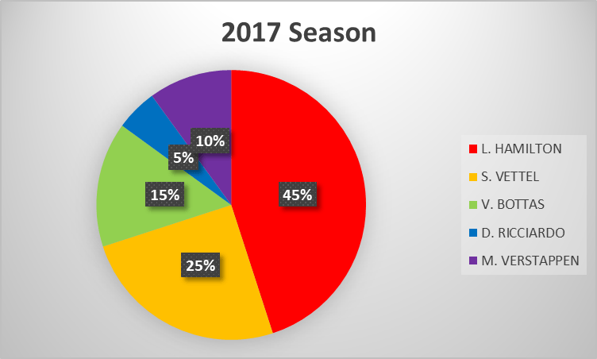
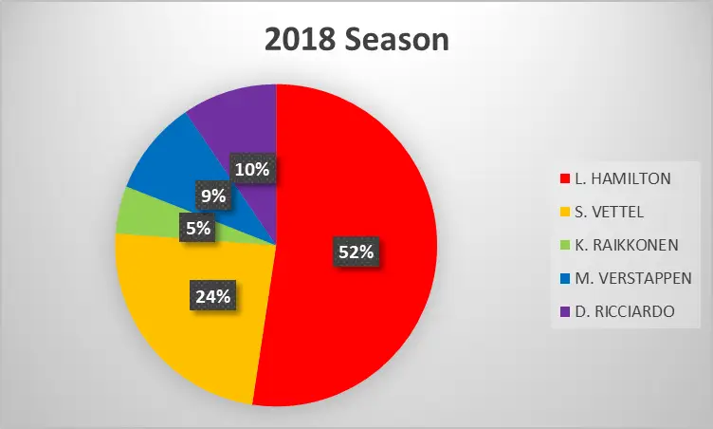
Proposal
Driver History
source - https://f1chronicle.com/is-formula-1-boring/

Slide 23
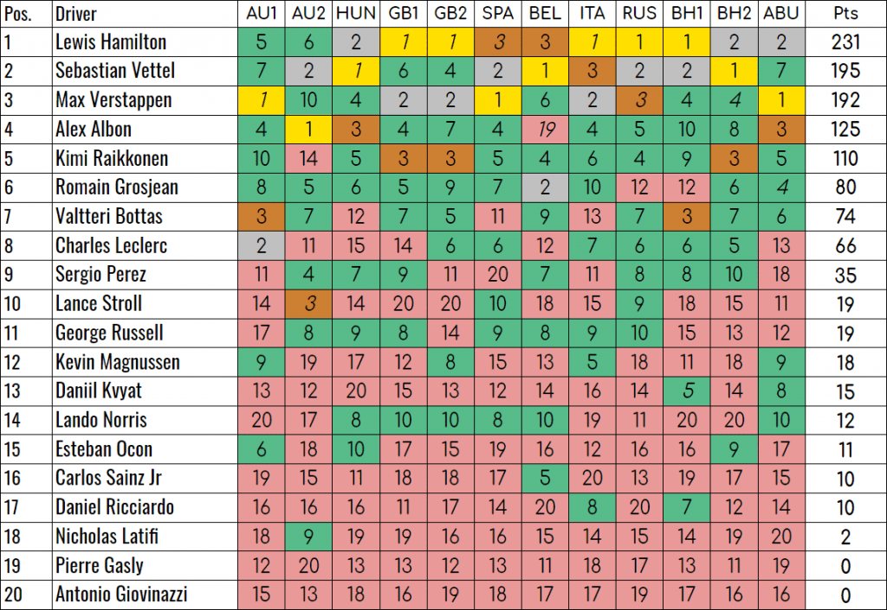
Proposal
Winner Prediction

Slide 24

References
J. Veiga, R. R. Expósito, X. C. Pardo, G. L. Taboada and J. Tourifio, "Performance evaluation of big data frameworks for large-scale data analytics," 2016 IEEE International Conference on Big Data (Big Data), 2016, pp. 424-431, doi: 10.1109/BigData.2016.7840633.
https://python-adv-web-apps.readthedocs.io/en/latest/flask_forms.html
https://pandas.pydata.org/pandas-docs/
https://www.tutorialspoint.com/flask/index.htm
https://pandas.pydata.org/pandas-docs/stable/user_guide/merging.html
https://pandas.pydata.org/pandas-docs/stable/user_guide/visualization.html

